Slide 1
Welcome to my presentation

Slide 2




The greatest problem in Bangladesh

Slide 3


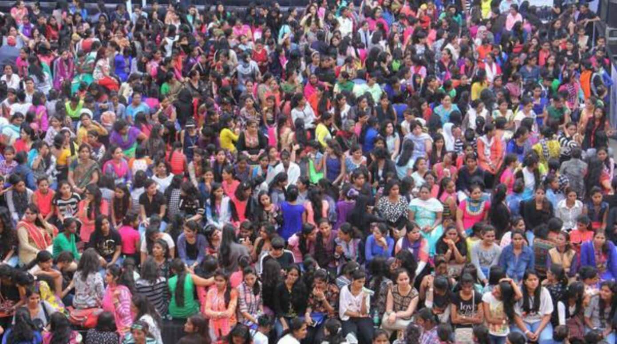
Major problem of Bangladesh
Unemployment
Corruption
Over population
corruption

Slide 4


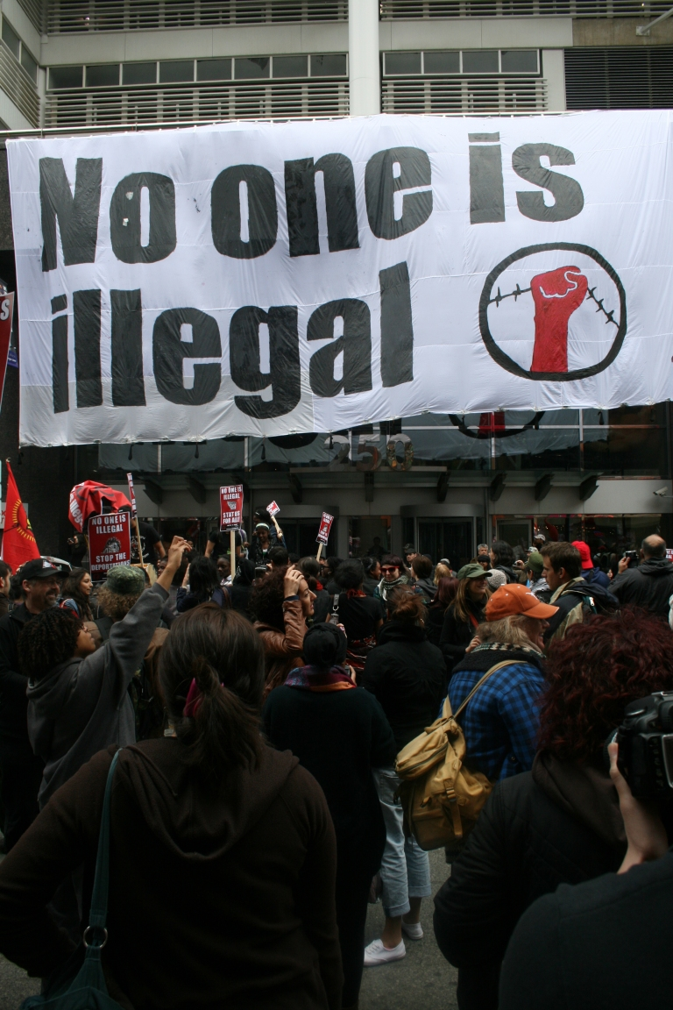

Causes of unemployment
Education system
Frustration
Nepotism
Illegal system of PSC

Slide 5
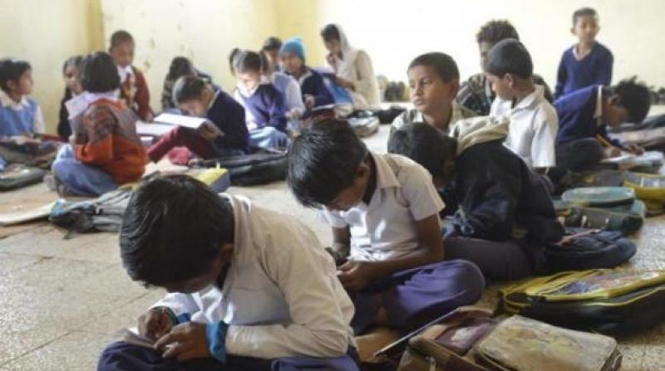

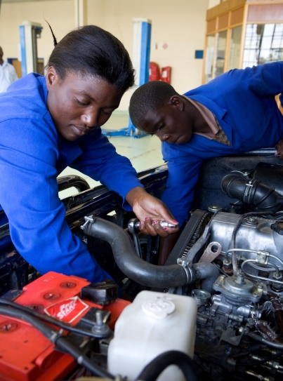
Remidies of unemployment
Education system should change immediately
Have to emphasize in technical training
Give us vocational training like,computer training,mechanical training,electrical and welding training also

Slide 6
Causes of corruption
High ambitious
Nepotism in job
Mentality
Poverty
Politically misuse of power
Improper implementation of laws

Slide 7
Steps to remove corruption
Must be anti corruption commission should be active
Law should be implement properly
Nepotism,corruption should be avoided
Government have to suspect and have to punish the corrupted people

Slide 8
CONCLUSION
Corruption is a social disease.It hampers our reputaion to other country.Therefore,anti corruption commision should stricker.Goverment should give punish to the corrupted employers.

Slide 9
THANK YOU ALL PRAY FOR ME
MAY ALLAH MERCY ON YOU

